Slide 1

Software Architecture and Design I SOEN 343 Instructor: Dr. Rodrigo Morales rodrigo.moralesalvarado@concordia.ca
Lecture 1: Introduction to software architecture
Textbook:
Software architecture and design illuminated / Kai Qian ... [et al.]
Publisher Sudbury, Mass. : Jones and Bartlett Pub., c2010.
Notes:
1

Slide 2
Objectives
• Introduce the relationship between software requirements and architecture
• Introduce the relationship between architectural styles and architecture
• Introduce the elements of software architecture
• Describe quality attributes trade-off analysis

Slide 3

Software architect
Software architects use various design strategies in software construction to divide and conquer the complexities of a problem domain and solve the problem

Slide 4
A good software design
Reduces risks in software production
coordinates development teams to work together orderly
Makes the system traceable for implementation and testing
Leads to software products that have higher quality attributes

Slide 5
The input of software design is a Software Requirements Specification (SRS)
The SRS is the result of requirement analysis; it records the functional and non-functional requirements that must be met by the software system.
The output of software design is a document called Software Design Description (SDD)
The SDD describes the software architecture or high-level design and the detailed design of the system.

Slide 6
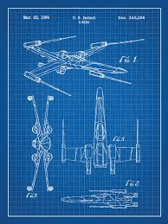
Software design description (SDD)
The SDD describes the components of a system, the modules that comprise each component, and the detailed information (such as data attributes, operations, and algorithms) of each module
From the SDD, the system is then implemented using programming language, which is followed by debugging, testing, and maintenance

Slide 7
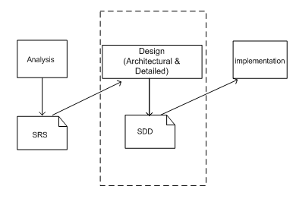
A simplified software development life cycle
Notes:
Software design is an early phase of the Software Development Life Cycle (SDLC)
During this phase, software designers model the system and assess its quality so that improvements may be made before the software goes into the production phase
SDLC consists of the following stages: software requirements analysis, software design (architecture and detailed); software development and implementation; and testing and quality assurance, maintenance and evolution
The dashed box depicts the scope of software design
The software requirements specification (SRS) provides the input necessary for the design.
SRS is the result of requirements analysis; it records the functional and nonfunctional requirements that must be met by the software system
What is the outcome of the software architecture design? In a few words is an overall representation of the software to be built

Slide 8
Sample outline of SDD based on IEEE Std 1016
Design overview, purpose, scope
Decomposition description (module, data, process)
Dependency and connection description (between modules, data, processes)
Attributes
User interface description
Detailed design (module and data)
Notes:
The IEEE std. 1016- Recommended Practice for software design descriptions (SDD) describes an organization for software design descriptions.

Slide 9
Architectural vs detailed design
The software design stage can be further split into two steps: the architectural design step and the detailed design step
During the architectural design step we describe user accessible components and the interconnections among them that are visible to stakeholders
During the detailed design step we specify the internal details of each component and we might introduce new invisible components (for the stake holder) into the design
Notes:
Notice that the software design stage can be further split into two steps: the architectural design step and the detailed design step
During the architectural design step we describe user accessible components and the interconnections among them that are visible to stakeholders.
During the detailed design step we specify the internal details of each component and we might introduce new invisible components – to the stakeholder, into the design

Slide 10

Architectural style
Designers abstract common features into “families of architectures”
Each style represents a layout topology of elements, and connections and interactions among these
It also describes its semantic constraints and behaviors concerning data transfer and control transfer among the elements in the system and the quality attributes trade-off as well

Slide 11
Architectural style
Quality attributes are closely related to architectural styles
Each architectural style supports some quality features
An architectural style encapsulates tradeoffs among many conflicting quality attributes

Slide 12
List of sample quality attributes:
Performance
Reliability
Portability
Usability
Security
Testability
Maintainability
Adaptability
Modifiability
Usability
Scalability.

Slide 13
Software Architecture: Bridging Requirements and Implementation

Slide 14
Relationship between software requirements and architecture
Requirements
Architecture
Implementation
Notes:
Software architecture plays a very important role in software development
The actual design is a blueprint and a guideline for developing a software system based on the software requirement analysis specification.
The architectural design embodies earliest decisions that have a decisive impact on the ultimate success of the software product
It shows how the system is structured in terms of components, and how its components work together
As the description of software construction structure, an architectural design must cover the software functional requirements and non-functional requirements as well
It serves as an evaluation and implementation plan for software development and for software evolution

Slide 15
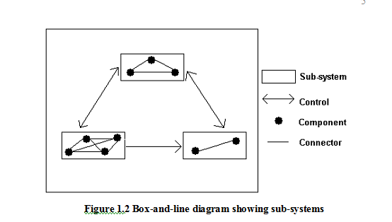
Box-and-line diagram showing an architecture design
Notes:
Figure 1.2 Reference 1.
The box-and-line diagram shows what an architecture design typically looks like.
Note that it does not contain the complete set of information found in a development blueprint. For example, it does not describe any quality attributes, or guidelines for programmers to follow.
In this diagram, each element symbolizes a sole responsibility cucha as business logic processing, logic control, interface presentation, etc.
The elements may be in the form of modules, objects, packages, deployed elements, tasks, processes, etc.
The topology of the static structure focuses on the system composition configuration (e.g., layered, centralized, or distributed).
The dynamic runtime connectors may be batch-sequential, asynchronous, message broadcasting, etc.

Slide 16
Software architecture definitions
IEEE Std 1471 defines the system architecture as “the fundamental organization of a system embodied in its components, their relationships to each other, and to the environment, and the principles guiding its design and evolution.”
Shaw and Garlan (1996) regard software architecture as “the description of elements that comprise a system, the interactions and patterns of these elements, the principles that guide their composition, and the constraints on these elements.”
Notes:
In the previous slide, the box-and-line diagrams illustrates the idea of software architecture. Now let's see two formal definitions.

Slide 17


A complete software architecture specification must describe not only the elements and connections between elements but also the constraints and runtime behaviors so that developers know what must be implemented and how it should be implemented.

Slide 18
Software architect’s tasks:
Perform system static partitioning and decomposition into sub-systems and communications between sub-systems
A software element can be configured, delivered, developed, deployed and is replaceable in future
Each element has its interface that encapsulates details and provides loose coupling with other elements or sub-systems

Slide 19
Software architect’s tasks:
Establish dynamic control relationships between different sub-systems in terms of data flow, or control flow orchestration, or message dispatching
Perform trade-off analysis on quality attributes and other non-functional requirements during the selection of architecture styles
Map the software requirements specification to the software architecture and guarantee that the software architecture satisfies functional and non-functional requirements
Notes:
Establish dynamic control relationships between different sub-systems in terms of data flow, or control flow orchestration, or message dispatching
Perform trade-off analysis on quality attributes and other non-functional requirements during the selection of architecture styles
The most important job for a software architect is to map the software requirements specification to the software architecture and guarantee that the software architecture satisfies functional and non-functional requirements

Slide 20
Architectural Styles
An architectural style abstracts the common properties of a family of similar designs
It contains a set of rules, constraints, and patterns of how to structure a system into a set of elements and connectors
It governs the overall structure design pattern of constituent element types and their runtime interaction of flow control and data transfer
Notes:
An architectural style (also known as “architecture pattern”) abstracts the common properties of a family of similar designs.
An architectural style contains a set of rules, constraints, and patterns of how to structure a system into a set of elements and connectors.
It governs the overall structure design pattern of constituent element types and their runtime interaction of flow control and data transfer.

Slide 21
The key components of an architectural style
Elements that perform functions required by a system
Connectors that enable communication, coordination, and cooperation among elements
Constraints that define how elements can be integrated to form the system
Attributes that describe the advantages and disadvantages of the chosen structure

Slide 22
Architectural styles
Batch Sequence, Pipe & Filter, Process Control (Data Flow)
Repository, Blackboard (Data Centered)
Object-Oriented
Layered, Virtual Machine, Main/Subroutine (Hierarchy)
Multi-tier, Client/Server (Distributed)
Event-Based, Buffered Messaging (Asynchronous Communication)
MVC, PAC (Interaction Oriented)

Slide 23
Quality Attributes
Each architectural style has its advantages, disadvantages and potential risks
Choosing the right architectural style to satisfy required quality attributes is also very important in addition to function satisfaction
Quality attributes are identified in the requirement analysis process

Slide 24
Implementation attributes (not observable at runtime)
Interoperability
Maintainability & extensibility
Testability
Notes:
Interoperability: This refers to the universal accessibility and the ability to exchange data with internal components and the outside world. It needs loose dependency of infrastructure
Maintainability & extensibility: This refers to the ability to modify the system and extend it conveniently
Testability: This refers to the degree to which the system facilitates the establishment of test cases. It usually requires a complete set of documentation accompanied with system design and implementation

Slide 25
Implementation attributes (not observable at runtime)
Portability
Scalability
Flexibility
Notes:
Portability: This refers to the level of independence of the system on software and hardware platforms.
Scalability: This refers to the ability to adapt to an increase of user requests volume. It disfavors bottlenecks in system design.
Flexibility: This refers to the ease of modification of a system to cater for different environment or problems for which the system is originally not designed. Systems developed using the component-based architecture or the service-oriented architecture usually possess this property.

Slide 26
Runtime attributes (observable at runtime)
Availability
Security
Performance
Usability
Notes:
Availability: This refers to the ability of a system to be available 24x7.
Security: This refers to the ability to cope with malicious attacks from outside or inside of the system.
Performance: This refers to increasing efficiencies such as response time, throughput and generally resource utilization, which most of the time conflict with each other
Usability: This refers to the level of “satisfaction” from a human perspective in using the system. Usability includes completeness, correctness, compatibility, and more critically user friendliness

Slide 27

Business attributes
Time to market
Cost
Lifetime
Notes:
Time to market: This refers to the time it takes from requirement analysis to the date product is released
Cost: This refers to expense of building, maintaining, and operating the system
Lifetime: This refers to the period that the product is “alive” before retirement

Slide 28

Some tradeoffs to consider
Tradeoff between space and time
Tradeoff between reliability and performance
Tradeoff between scalability and performance
Notes:
Tradeoff between space and time. For example, to increase the time efficiency of a hash table means to decrease its space efficiency.
Tradeoff between reliability and performance. For instance, Java programs are well protected against buffer overflow due to its security measures such as boundary check on arrays. Such reliability features come at the cost of time efficiency, compared with the simpler and faster C language which provides the “dangerous” yet efficient pointers.
Tradeoff between scalability and performance
For example, one typical approach to increase the scalability of a service is to replicate servers. To ensure consistency of all servers (e.g., to make sure that each server has the same logically consistent data), performance of the whole service is sacrificed

Slide 29
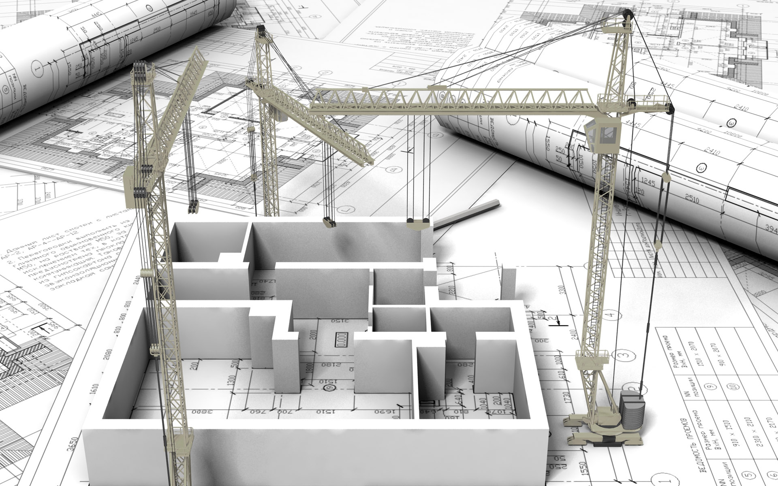
Software Architecture Design Guidelines

Slide 30
Think of what to do before thinking of how to do it
Functional and non-functional requirements should be identified, verified, and validated before architectural and detailed design
Using an abstract architectural design of a system to communicate with stakeholders helps avoid overhauling the system design in later stages of the software development cycle

Slide 31
Think of abstract design before thinking of concrete design
Always start with an abstract design that specifies interfaces of components and abstract data types
Use multiple levels of abstraction if necessary
Make all implementation decisions depend on the abstract interfaces instead of concrete ones because those are more stable
Notes:
Always start with an abstract design that specifies interfaces of components and abstract data types
Use multiple levels of abstraction if necessary
Make all implementation decisions depend on the abstract interfaces instead of concrete ones because those are more stable – they are the contracts between service providers and services requesters so they are defined at the early stages of software development cycle.

Slide 32
Think of non-functional requirements earlier
When we map functional requirements to an architectural design, we should consider non-functional requirements as well
Communicate with stakeholders and document their preferences of quality attributes
It is not possible to find a design that meets all quality attributes
Balance the quality attributes and consider heterogeneous architecture styles when necessary
Notes:
When we map functional requirements to an architectural design, we should consider non-functional requirements as well.
Communicate with stakeholders and document their preferences of quality attributes.
It is not possible to find a design that meets all quality attributes.
Balance the quality attributes and consider heterogeneous architecture styles when necessary.

Slide 33
Think of software reusability and extensibility as much as possible
For most software systems, it is very likely that new functionalities will be added after they are deployed
In addition, we need to consider how to reuse existing software components to increase the reliability and cost-effectiveness of new systems
Always try hard to make software extensible in the future

Slide 34
Tolerate refinement of design
Never expect to have software design completely perfect within one step
We may need to use prototyping and iteration to refine the software design
Avoid ambiguous design and over-detailed design
Ambiguous design lacks constraints and over-detailed design restricts implementation

Slide 35
Summary
Software architectural design has emerged as an important part of software development
A software architecture specification consists of software elements, connections and collaborations among the elements, and desired software quality attributes

Slide 36
Summary (cont.)
An architectural style is a set of rules, constraints, or patterns that guide how to structure a system into a set of elements and connectors, and how to govern overall structure design patterns of constituent element types and their runtime interaction
One specific architectural style may not be able to honor all quality attributes of the system

Slide 37
Summary (cont.)
There are always quality attribute tradeoffs between different styles
Hence, how to keep a balance on quality attributes is an important design issue

